Slide 1
The Ground Truth (What is broken?)
Idea Name(s):
Author(s):
What are the exact points of friction?
(e.g., Instead of "Farmers lose money," write "Chilli farmers lose 30% of their crop value during sun-drying due to unpredictable rain.")
Who exactly is feeling this pain the most? Be specific. (e.g., Not just "Farmers," but "Marginal farmers with less than 2 acres.")
How are they surviving this problem today? What is their current, broken workaround or alternative?
Why does their current workaround suck?
(If the current workaround is actually "good enough," we don't have a startup idea yet).
Designed for AgriPreneur Community and is intended for sharing ideas and use cases, any one who uses or reads this will need to maintain confidentiality of the idea and not replicate some one else’s work
Notes:
B3I - reinsure

Slide 2
The Market Scale (Does this problem matter?)
Idea Name(s):
Author(s):
Is this an Immediate need or a Frequent need? (e.g., Does this pain happen every single day, or once a year?)
Are there a several (eg:Lakhs of) people facing this exact same friction, and is that number growing?
What is this problem currently costing the victim in Rupees or wasted labor?
Are they genuinely frustrated enough to pay for a fix?
If we build the perfect solution tomorrow, what is the #1 reason the user might still say "No thanks"?
Designed for AgriPreneur Community and is intended for sharing ideas and use cases, any one who uses or reads this will need to maintain confidentiality of the idea and not replicate some one else’s work
Notes:
B3I - reinsure

Slide 3
Business Model Canvas
Key
Partners
Key
Activities
Value
Proposition
Customer
Relationships
Customer
Segments
Key
Resources
Channels
Cost Structure
Revenue Streams
Notes:
https://canvanizer.com
https://www.youtube.com/watch?v=RpFiL-1TVLw

Slide 4
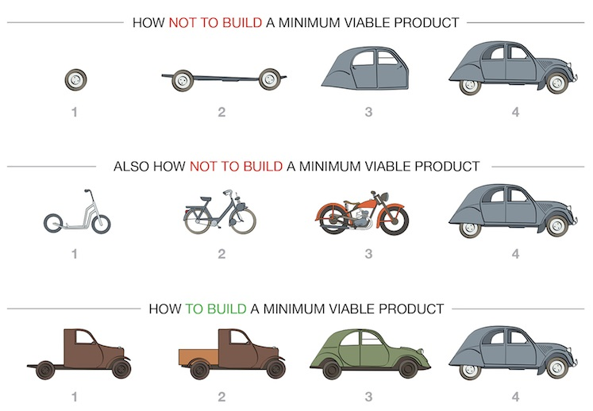
BUILDING AN MVP

